Slide 1
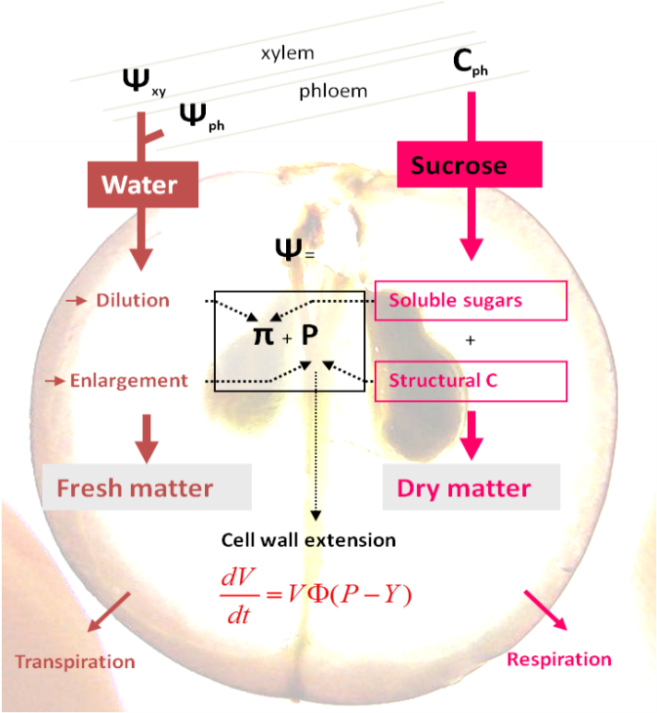


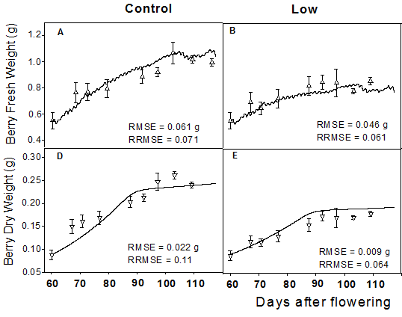
Biophysical berry growth model
Effect of leaf-to-fruit ratio
High
Low
Days after flowering
Dai et al., 2008. Act. Hort
Notes:
The fruit growth results from the accumulation of water and carbon. Water enters fruit through both xylem (xyl) and phloem (phlo) and losses by transpiration influenced by air humidity and temperature. Carbon enters fruit through phloem and losses by respiration influenced by temperature. Water influx is driven by the water potential (ψ) gradient between xylem/phloem and fruit. The fruit volume (V) extension is driven by turgor pressure (P), governed by the Lockart equation. π is fruit osmotic pressure. Φ and Y are cell wall extensibility and yield threshold, respectively.

Slide 2
Biophysical berry growth model
Dry mass
Fresh mass

Slide 3
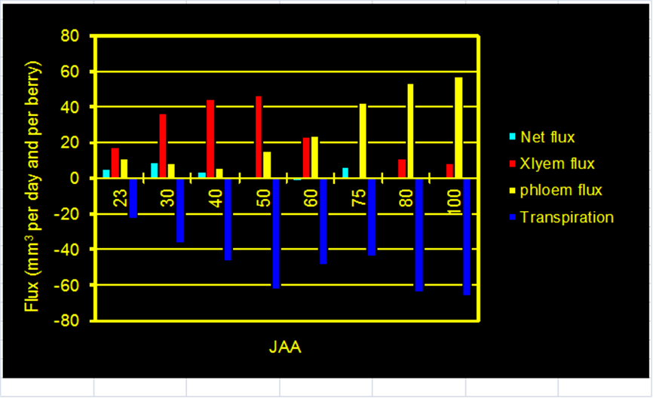
Biophysical berry growth model
Water fluxes
Simulation
Measurement by Ollat et al. 2002

Slide 4
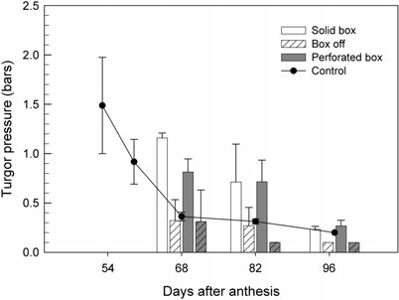
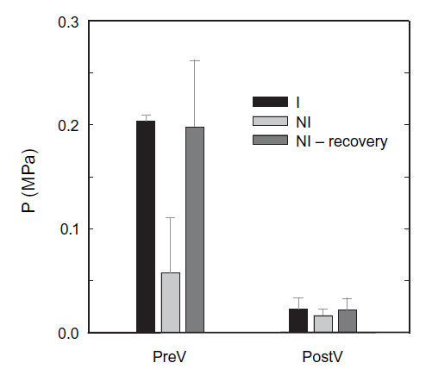
Biophysical berry growth model
Turgor pressure
Matthews et al.,2009
Simulation
Thomas et al.,2006

Slide 5
Biophysical berry growth model
Demonstration with R

